Slide 1
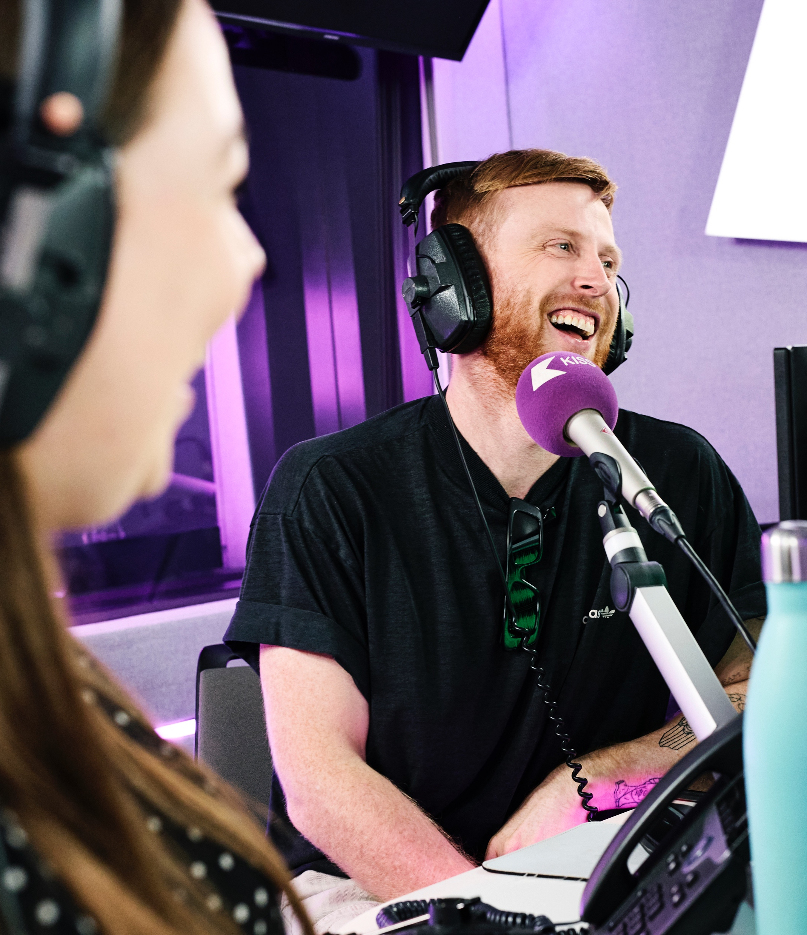

Visit Isle of Wight Ltd
Twixmas 2025
Post Campaign Analysis

Slide 2
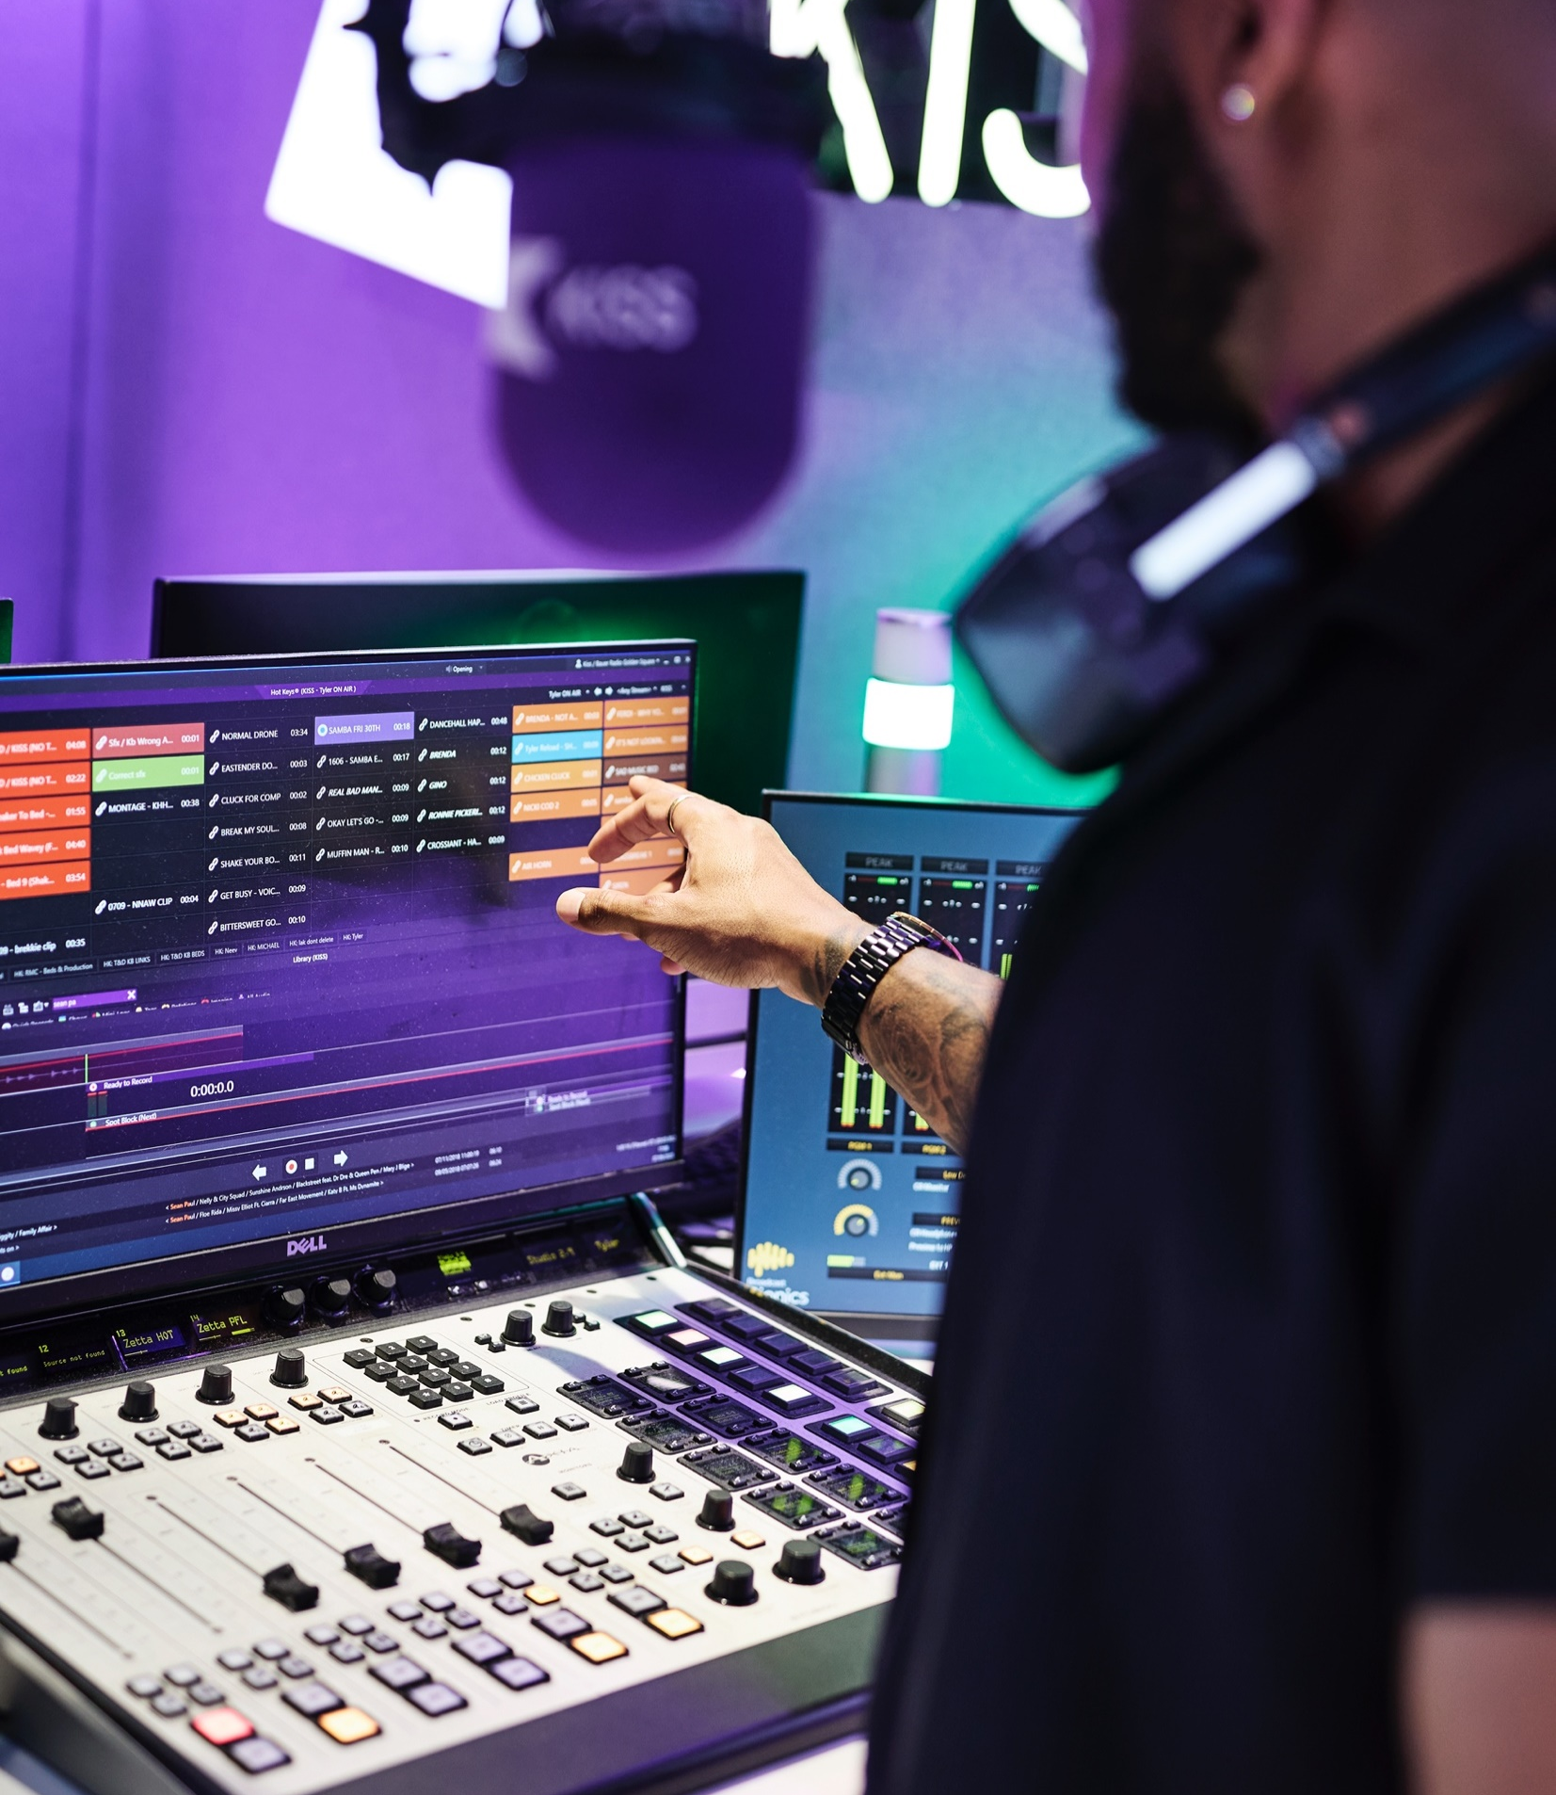


AudioXi
Campaign overview
Here’s a reminder of your campaign
  LOCATION: Birmingham, Bristol, Bath & Oxford
  DURATION: 26/12/25 – 31/01/26
  TARGETING: 55-64 , 65+ & Parents & Families
  BRANDS: All devices, all Bauer brands
  IMPRESSIONS BOOKED: 444,444

Slide 3
AudioXi Campaign Results
Campaign | Impressions | Listen Through Rate % | Unique Listeners
55+ DEC - JAN | 275,000 | 99.09% | 55,072
PARENTING & FAMILIES DEC - JAN | 213,890 | 99.55% | 18,230
Total / Average | 488,890 | 99.32% | 73,302

Slide 4
Location Split AudioXi Campaign
Campaign | Impressions | Listen Through Rate % | Unique Listeners
Birmingham County | 241,601 | 98.67% | 38,370
Bristol / Bath County | 224,859 | 99.04% | 28,158
Oxfordshire | 22,430 | 99.39% | 6,774
Total / Average | 488,890 | 99.32% | 73,302

Slide 5
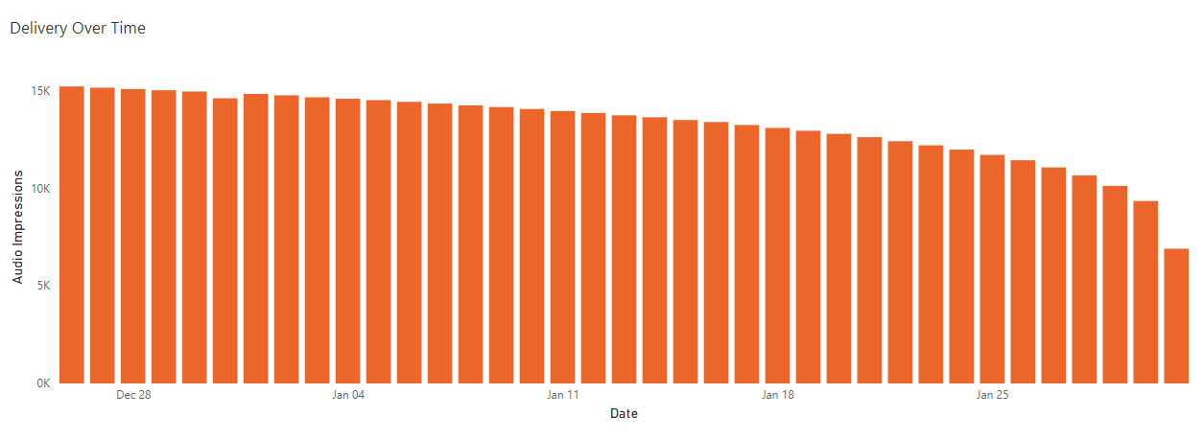
Daily Delivery
Delivery of impressions from the start to the end of your campaign
  Chart to show impressions delivered by day

Slide 6
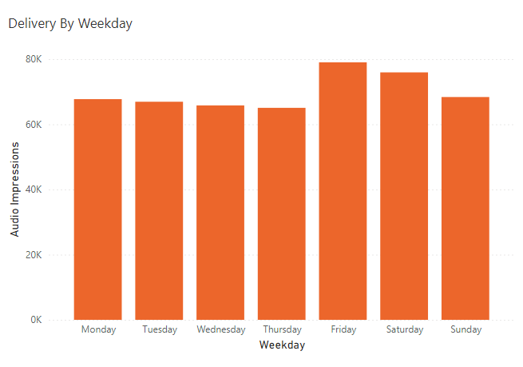
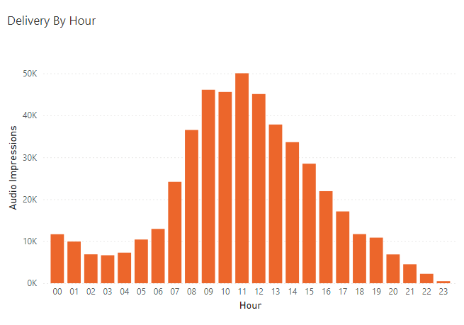
Delivery Trends
Delivery per day of week and hour
  Chart to show peak delivery times of your advert, by day and time

Slide 7
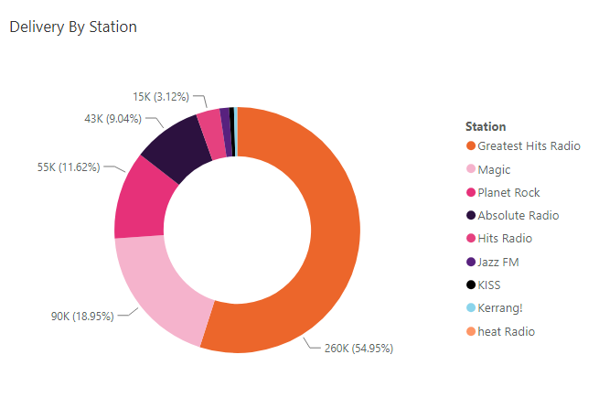

Delivery Insights
Impressions split by Station
  Pie chart to show split of delivery by Bauer stations
Your top station was

Slide 8
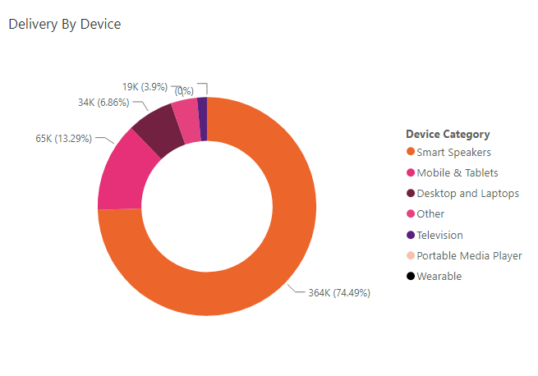
Delivery Insights
Impressions split by Device
  Pie charts to show split of delivery
Delivered mostly on
Smart speakers

Slide 9

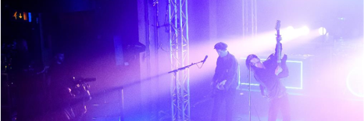
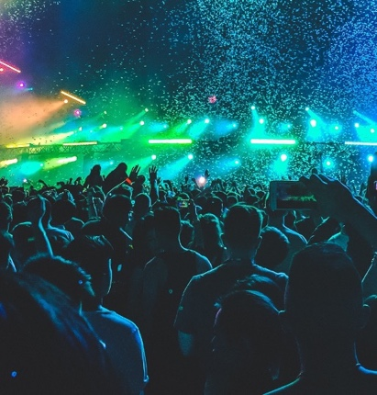
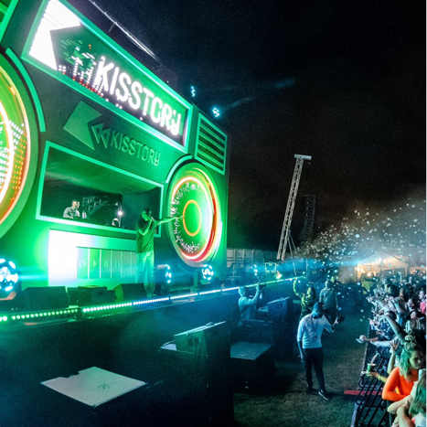
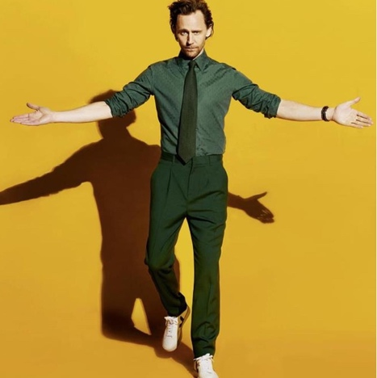







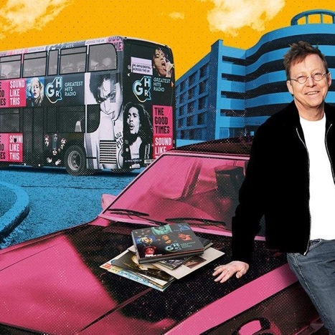

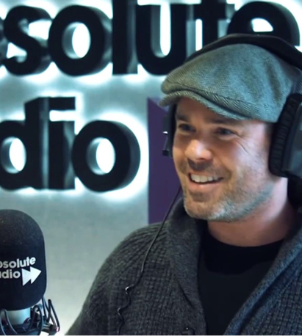

Key Terms
Campaign Delivery Terms:
Impressions – The total number of times your audio ad was played to listeners.
Listen Through Rate (LTR) – The percentage of ad plays that were listened to from start to finish.
Unique Users – The number of individual people who heard your ad at least once.
Devices:
Smart Speakers – e.g. Amazon Echo, Google Nest, Apple HomePod.
Mobile & Tablets – e.g. iPhone, Android phones, iPad, Samsung Galaxy Tab.
Desktop and Laptops – e.g. Windows PCs, iMacs, MacBooks, Chromebooks.
Television – e.g. Smart TVs, Amazon Fire Sticks, Roku TV.
Portable Media Player – e.g. iPod Touch, Android based Sony Walkman and players.
Other – e.g. games consoles, in‑car audio systems, smart watches.

Slide 10
Thank you.

