Slide 1


Tourism Business Development Opportunities with VisitEngland & VisitBritain
VisitEngland Awards for Excellence 2022 © VisitEngland/ SimonHadleyPhotography
Notes:
Please click the icon to add image
Right click, Send to Back, Send to Back to place the picture in the background.

Slide 2
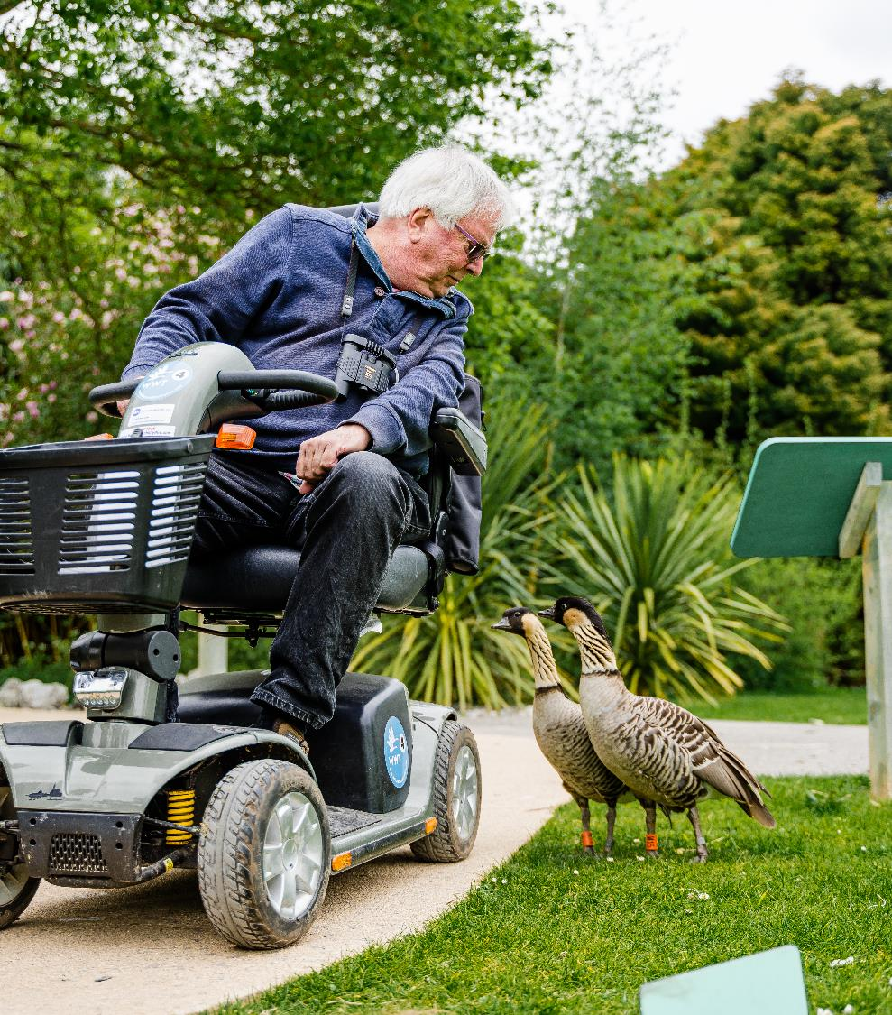

Introduction
Thank you for contacting us to help your business to grow.
Use this deck to identify a series of opportunities available from VisitEngland and VisitBritain to help develop your business.
WWT Slimbridge Wetland Centre, Gloucestershire
© Clem Stevens
Accessible and Inclusive Tourism Award Bronze Winner, 2023
Notes:
Please click the icon to add image
Right click, Send to Back, Send to Back to place the picture in the background.

Slide 3
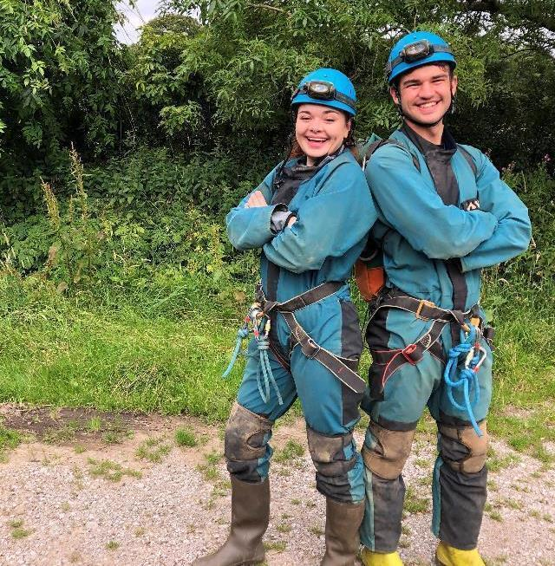

Keep up to date
Here’s a couple of suggestions on how to keep-up to date with the industry:
  Sign-up to our Industry E-news
  Sign-up for our fortnightly newsletter to be the first to receive our latest:
    international market intelligence
    partnership marketing opportunities
    tourism industry events
    news
  Industry Social Media
Check out our social channels:
  X (Twitter) @VisitEnglandBiz
  YouTube @VisitEnglandBiz
  LinkedIn @VisitEngland
https://www.visitbritain.org/newsletter_signup
Pure Outdoor, Derbyshire
Ethical, Responsible & Sustainable Tourism Award, Gold Winner, 2023
Notes:
Please click the icon to add image
Right click, Send to Back, Send to Back to place the picture in the background.

Slide 4
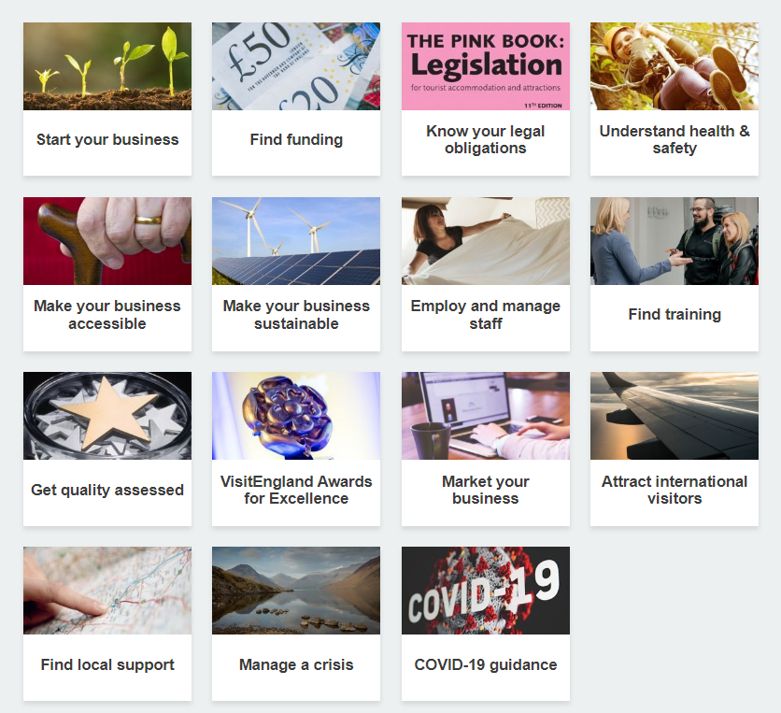

VisitEngland’s Business Advice Hub
Find a whole range of business advice for your tourism business from
VisitEngland’s Business Advice Hub.
The Business Advice Hub can help your tourism business to grow, including:
practical tips
useful toolkits
links to trusted resources
details on how to be legally compliant
how to access local support
www.visitengland.org/businessadvice

Slide 5
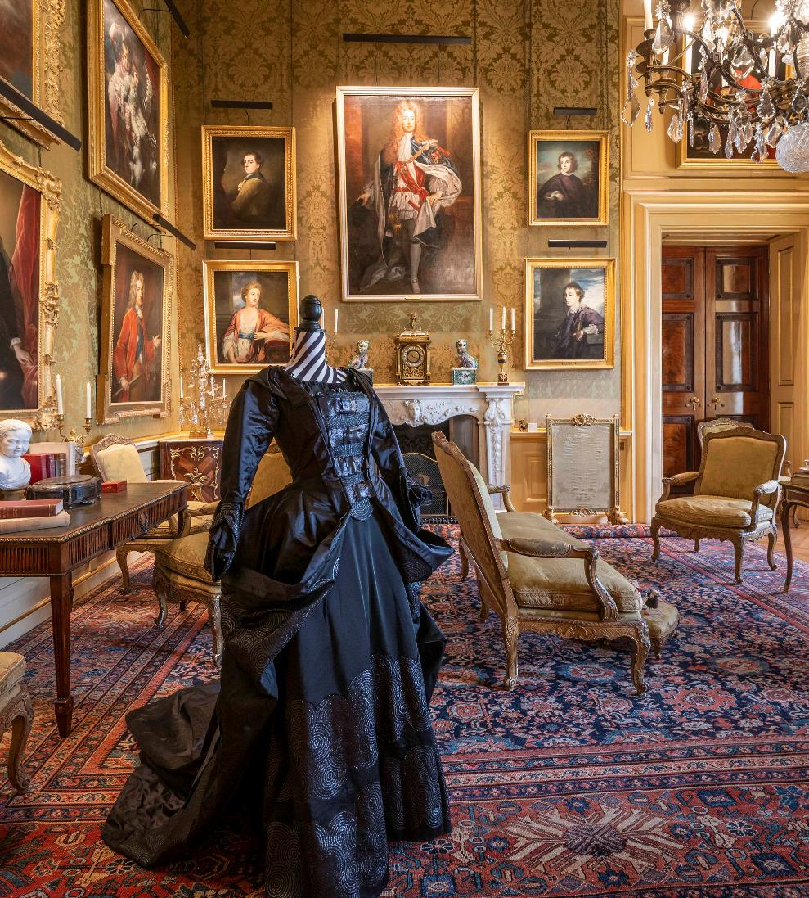

Useful Tools
  The VisitEngland Business Advice Hub contains numerous hugely helpful resources, why not look at the following suggestions:
  The Pink Book: legislation for tourist accommodation and attractions (12th Edition)
  Essential guidance on the legal obligations of tourism accommodation and attraction businesses in England
  Introduction to PR Toolkit
    For tourism-focused SMEs (small or medium-sized enterprises) who are not marketing professionals. Includes: who to contact, what exactly to say, how best to say it and when to say it
  Digital Marketing Toolkit
  For SME tourism businesses and looks at the benefits of a digital marketing strategy and how to maximise digital channels for your business, including real-life tourism business case studies
Blenheim Palace, Oxfordshire
Large Visitor Attraction of the Year, Silver Winner, 2023
http://www.visitengland.org/businessadvice
Notes:
Please click the icon to add image
Right click, Send to Back, Send to Back to place the picture in the background.

Slide 6
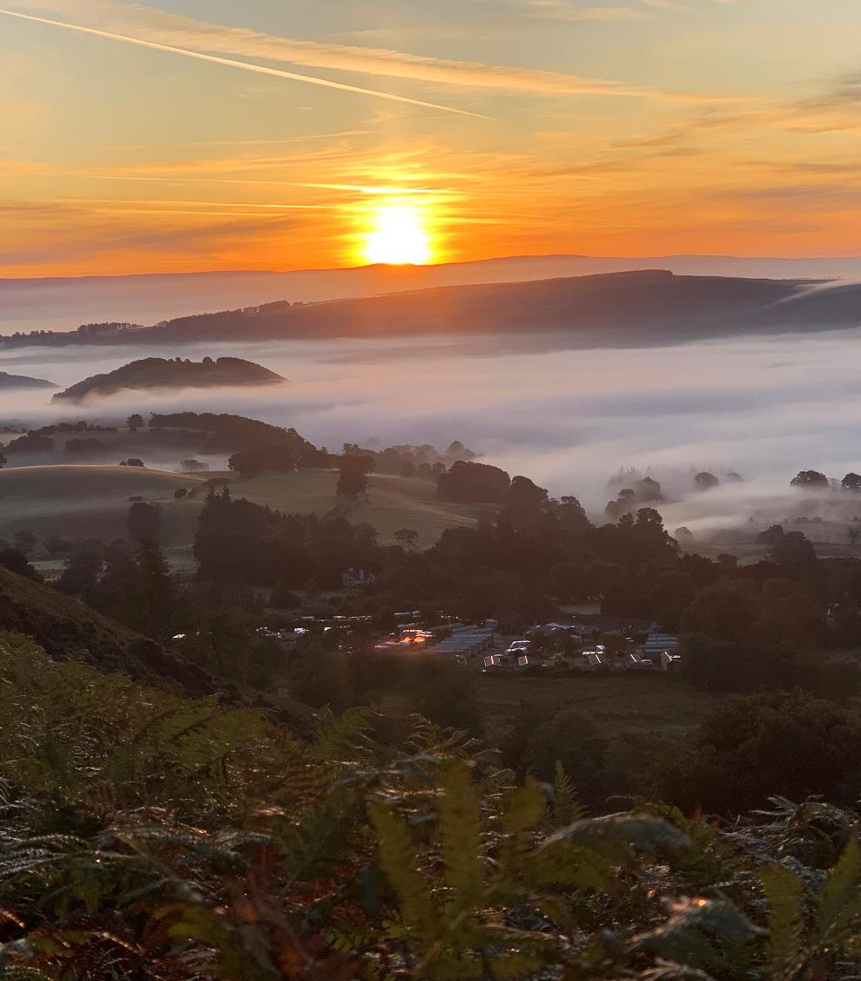

Develop your business
  Why not consider these development opportunities?
  Get star rated
  Gaining an official star rating or accreditation from the national tourism agency proves your commitment to quality, gives potential customers a label they can trust and can set you apart from your competitors
  Improve your sustainability
  Being sustainable not only reduces your impact on the environment, but helps you to improve your customer experience, support your local economy and stand out from your competitors
  Improve your accessibility and inclusivity
Do you want to extend your season, obtain loyal customers and gain a share of a £15.3 billion market? Find guidance, tools and resources to help you provide access for all
Become a winner in the VisitEngland Awards
for Excellence
You’ve got to be in it to win it! Entering tourism awards can help you improve business performance, create PR opportunities and show that you provide a truly excellent customer experience.
http://www.visitengland.org/businessadvice
The Quiet Site, Cumbria
Camping, Glamping and Holiday Park of the Year, Gold Winner, 2023
Notes:
Please click the icon to add image
Right click, Send to Back, Send to Back to place the picture in the background.

Slide 7


Get international ready
  Would your business benefit from more visitors from overseas?
  Sign-up for the Taking England to the World course
    free course
    in-person (1 day) or virtual (3x 2hour sessions)
    created and delivered by industry experts
    skills to develop and promote your product in key markets
    includes all aspects of getting ready to work with the travel trade:
      to attract new customers
      overview of the key overseas markets to England
      information on insights and research, marketing, product development, distribution and partnerships
https://www.visitbritain.org/taking-england-world-trade-education-programme
St Luke’s Bombed Out Church C.I.C, Merseyside
© David Munn
Resilience and Innovation Award, Gold, 2023
Notes:
Please click the icon to add image
Right click, Send to Back, Send to Back to place the picture in the background.

Slide 8
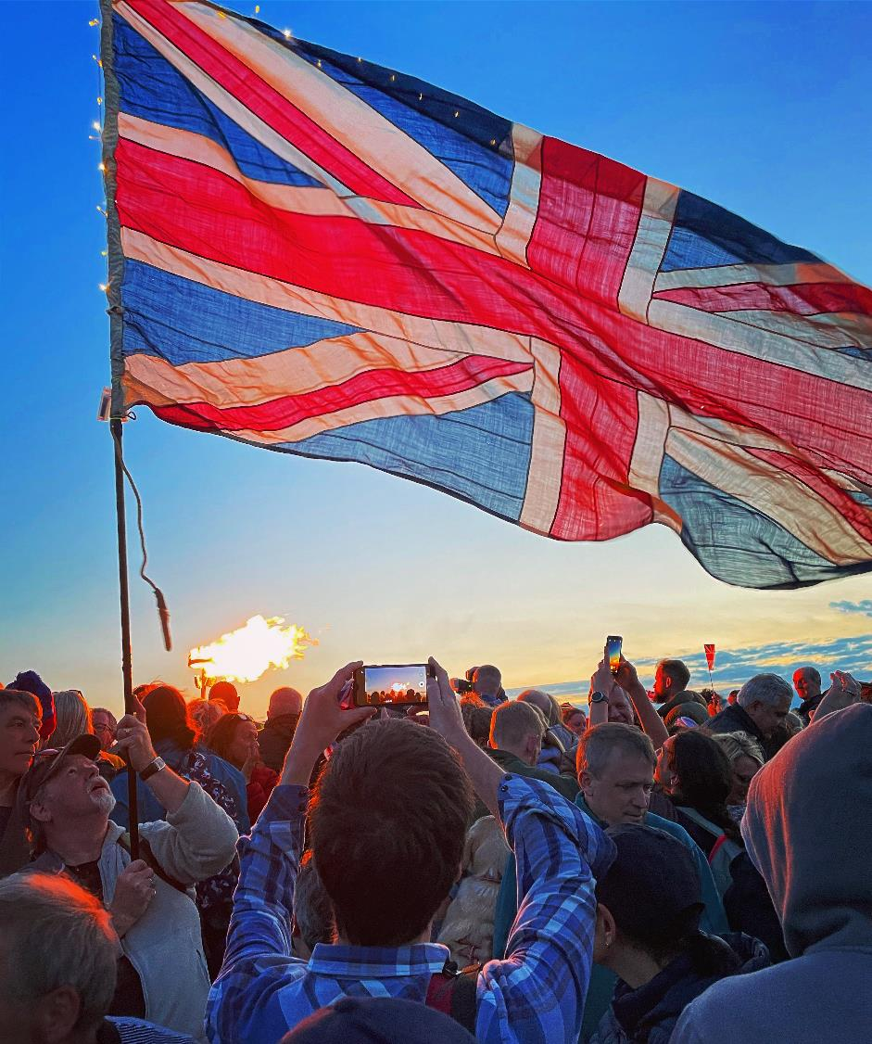
UK Tourism Business Support
For UK tourism businesses outside of England, similar business support resources are available from the other national tourist boards:
Northern Ireland
https://www.tourismni.com/business-guidance/home/
Scotland
https://www.visitscotland.org/supporting-your-business
Wales
https://businesswales.gov.wales/tourism/
© VisitBritain/Dan Smith

Slide 9
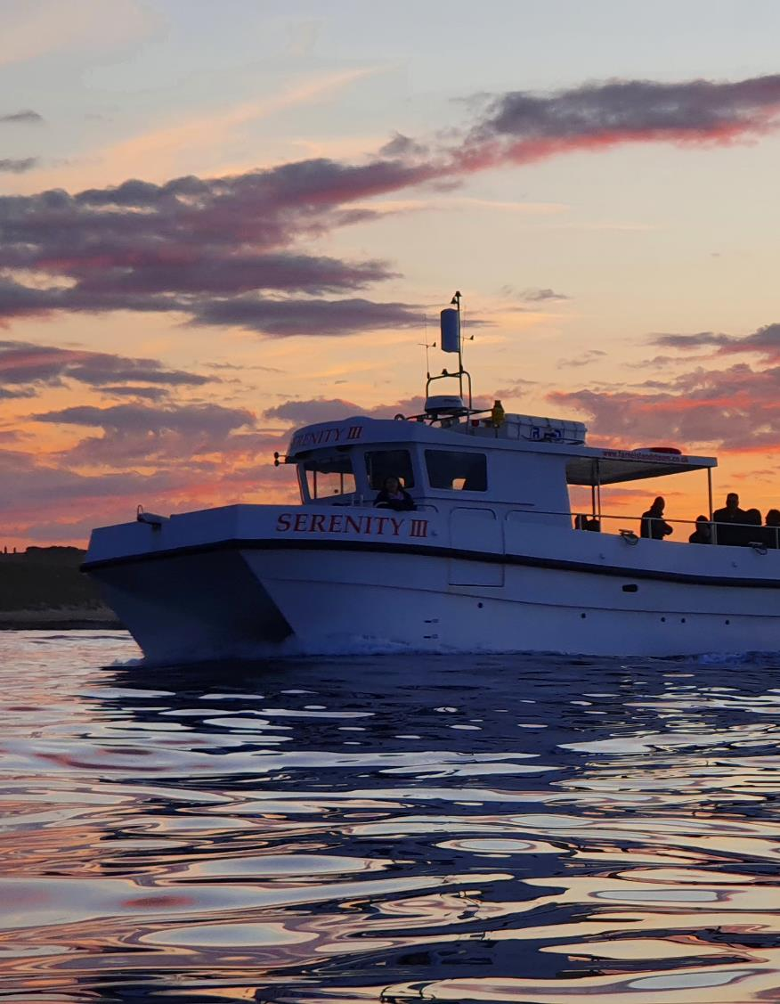

Improve your bookability
How about driving more sales with Tourism Exchange GB (TXGB)?
TXGB is a digital platform that brings together tourism businesses to drive sales and boost productivity by connecting the market in a new and unique way.
Accommodation, attractions, experiences, tours and events can connect with TXGB to reach new customers through a broad range of distribution channels and unique campaigns, brought together in one platform
  niche distributors
  well-known global brands
  over 100 regional and local destination websites
Opt-in to as many distributors as you like
Make updates whenever you wish
Connect your existing booking system
Use the TXGB free inventory loading tool TXLoad, to share live availability and prices across your chosen sales channels
Use TXLoad if you are not yet bookable online – it’s a free inventory loading tool that enables you to drive bookings via your own website or social profiles and opt-in to multiple sales channels
No setup costs, monthly fees or support charges - pay only when you take a booking (Pay a TXGB booking fee of 2.5% + VAT, plus the commission of your chosen sales channels (opt-in to as many as you wish)
Start your connection
Serenity Farne Island Boat Tours, Northumberland © Andrew Douglas
Experience of the Year, Gold Winner, 2023
www.txgb.co.uk
Notes:
Please click the icon to add image
Right click, Send to Back, Send to Back to place the picture in the background.

Slide 10
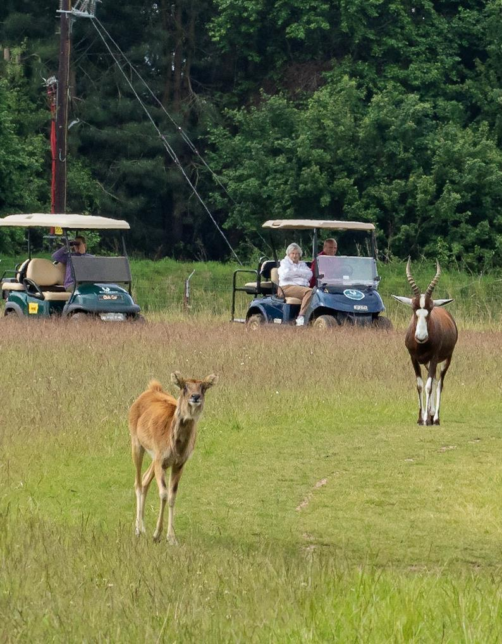

Improve your bookability (2)
What about fast tracking your domestic and global distribution with the VisitBritain Shop?
The VisitBritain shop is a multilingual and multicurrency hub of over 500 bookable experiences across more than 300 UK destinations:
Sign up to become a supplier of VisitBritain Shop
Get your experiences retailed on our site
Reaching a domestic and international network of 94 markets
Includes additional distribution via the VisitBritain affiliate scheme
Promotes your product internationally with an active B2B presence in overseas markets
    (We are currently unable to retail accommodation and overnight stay tours via the VisitBritain Shop)
The main route to be bookable on the VB Shop is via TXGB
(see previous slide)
www.VisitBritainshop.com
Watatunga Wildlife Reserve, Norfolk © Phil Stone
Small Visitor Attraction of the Year Award, Gold, 2023
Notes:
Please click the icon to add image
Right click, Send to Back, Send to Back to place the picture in the background.

Slide 11

Market insights & market webinars
  Do you know which international markets you could attract?
  We have a wealth of data on the different characteristics of international visitors, including the senior and youth segments, those visiting friends and relatives, as well as the business visits and luxury segments.
  Register to upcoming webinars
    Market introduction
    Trade Research and Insights by our research experts
    Trade updates and tips on how to work with the market, product demand and trends
    Live and pre-submitted Q&A
    Watch past market webinars
  Download our latest market research
    https://www.visitbritain.org/england-research-insights
    https://www.visitbritain.org/inbound-research-insights
    https://www.visitbritain.org/markets-segments
Cedar Manor, Cumbria © Cedar Manor
B&B and Guest House of the Year, Silver Winner, 2023
Notes:
Please click the icon to add image
Right click, Send to Back, Send to Back to place the picture in the background.

Slide 12
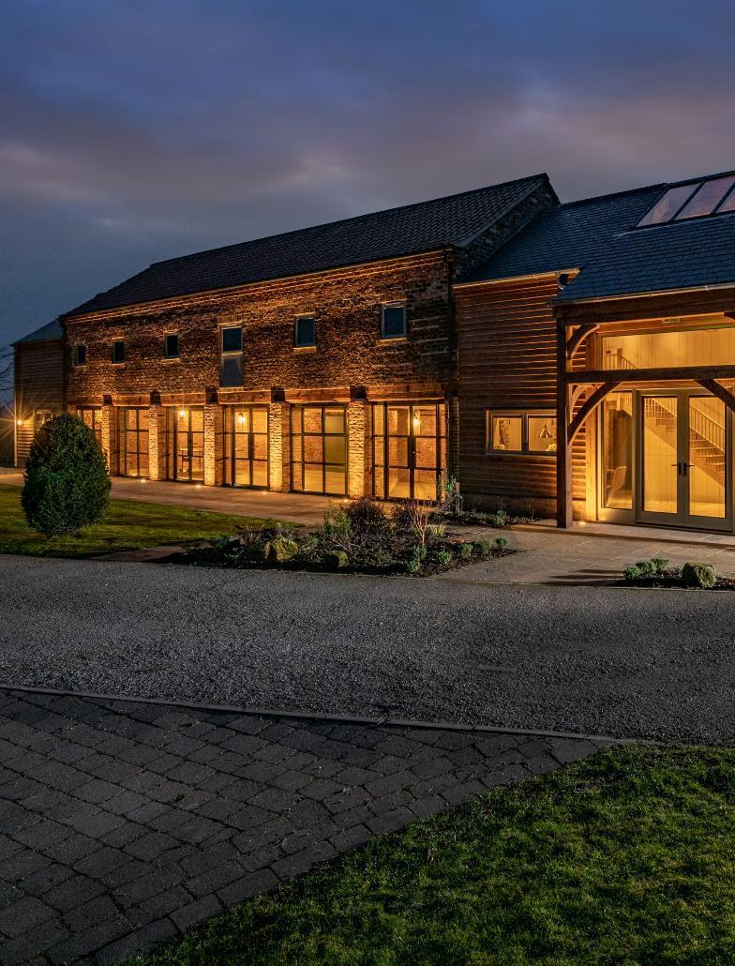


Create your network
  Why not develop your network of industry contacts?
  Extend your knowledge of the British tourism industry
  Align your business and activities with your local LVEP* /DMO**
  Find the nearest local support provider using the VisitEngland local support finder
  Engage with local DMCs*** to help represent your business globally
  Check out Trade Associations to help build a portfolio of contacts such as www.ukinbound.org, www.etoa.org, www.beta-uk.org
  *LVEP – Local Visitor Economy Partnership - Strategic and high-performing organisations recognised by VisitEngland. Lead, manage and market destinations, collaborate locally and nationally.
  **DMO – Destination Management Organisation - Might deliver marketing of local destinations, contact with tourism businesses, services and infrastructure for visitors.
  ***DMC – Destination Management Company - a professional services company with local
  knowledge, expertise and resources, working in the design and implementation of events, activities, tours, transportation and program logistics.
The Dovecote Barns, York ©The Dovecote Barns
Self Catering Accommodation of the Year, Silver Winner, 2023
Notes:
Please click the icon to add image
Right click, Send to Back, Send to Back to place the picture in the background.

Slide 13
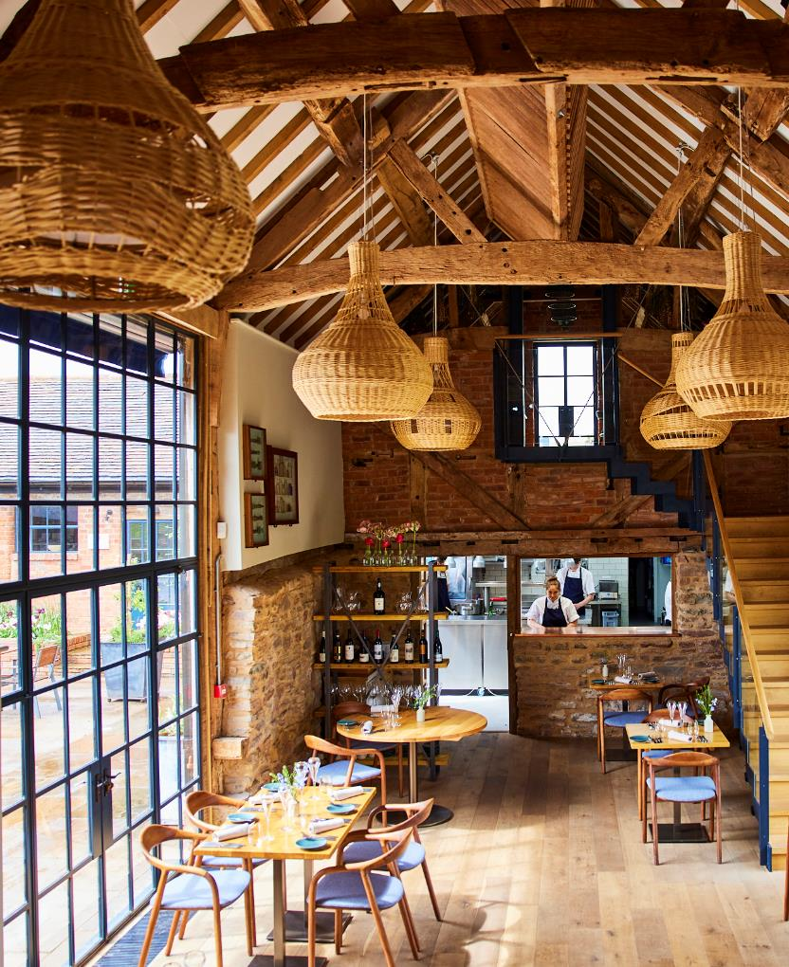
Travel trade events
  Would you like to know more about the travel trade?
  Get involved with travel trade events
    Once your business is international-ready it is good practice to host international buyers and media and attend domestic and international events
    Identify which markets you want to target
    Identify your available resources
    Start small and local
    Expand later into bigger events in Europe and Worldwide
  For example;
    Educational trips & Showcase Britain
      UK based events such as WTM (World Travel Market) and other trade shows
    Overseas based events such as Trade Shows and Missions and Workshop (pre-set 1-2-1 meetings) that happen annually globally
  Use our online events calendar
  Learn how to make the most out of missions, exhibitions & events
Pensons Restaurant at the Netherwood Estate, Worcestershire © David Loftus
Taste of England Award, Gold, 2023

Slide 14
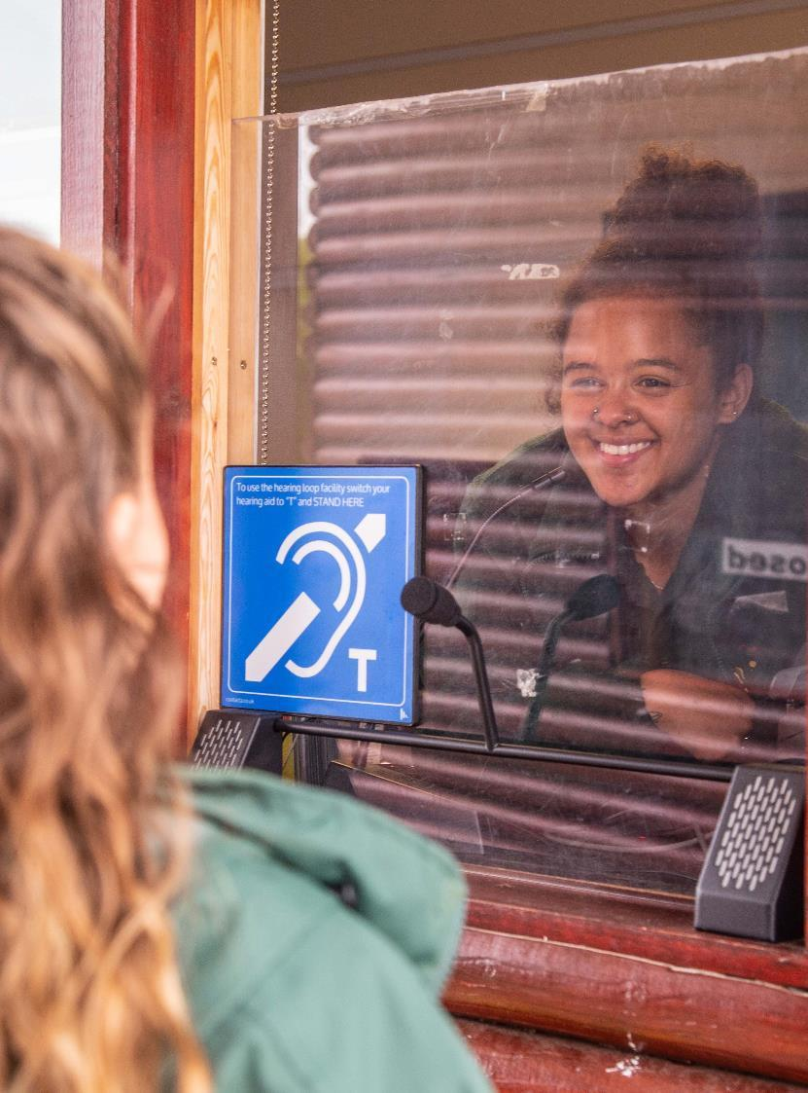
International VisitBritain teams
Interesting in finding out more about
our International travel trade teams?
VisitBritain has teams in over 20 overseas offices, offering a comprehensive range of support to international trade (Overseas Buyers).
Their key goal is to keep the UK top of mind to international audiences.
Work with the International Teams by:
Informing them of any new opening, new exciting opportunities that are internationally relevant
(contact details for each market can be found in the above link)
Informing them when you develop new material in a local language or when you have new visitors from their market
Working closely on educational opportunities both live and virtual (refer to your local DMO/LVEP for more info – see slide 12)
  https://www.visitbritain.org/meet-our-international-travel-trade-teams
Noah’s Ark Zoo Farm, Bristol
© Noah’s Ark Zoo Farm
Accessible and Inclusive Tourism Award,
Gold Winner, 2023

Slide 15

Keep in touch
www.visitbritain.org/businessadvice
www.visitbritain.org/opportunities-campaigns-resources
Britain Travel Trade:
www.visitbritain.org | Twitter: @VisitBritainBiz | LinkedIn: VisitBritain England Travel Trade/ Tourism Businesses:
www.visitengland.org | Twitter: @VisitEnglandBiz | LinkedIn: VisitEngland

